Slide 1

Apple Inc.
Innovation/Corporate Entrepreneurship
Stephen Leader, Jonah Rehg, Hudson Johnson, Parth Patel

Slide 2
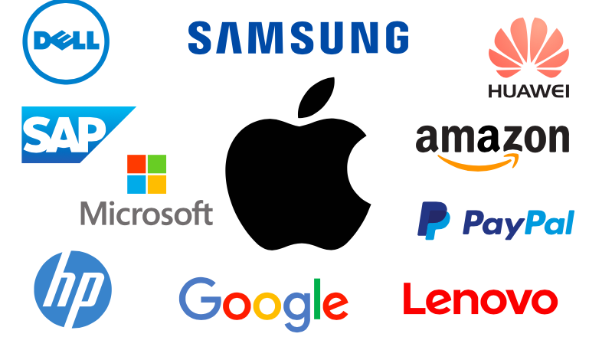
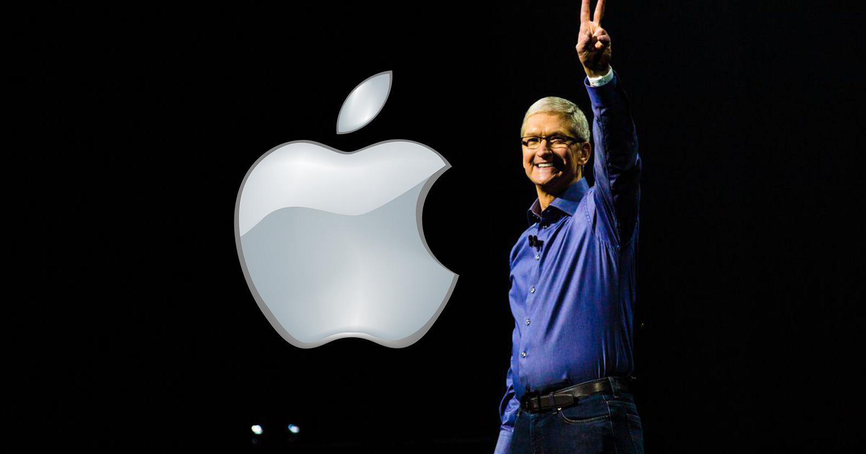
Key Players
Top 5 Competitors:
Dell
Google
Samsung
Hewlett-Packard
Microsoft
Founders:
Stephen ‘Woz' Wozniak
Steve Jobs
Current CEO:
Tim Cook
Notes:
Steve Jobs died 2011
Co-founders
Laptops are biggest competitor
Most people have iphones

Slide 3
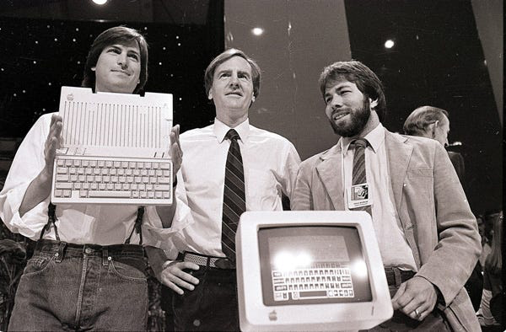
Background
American based multinational company
Founded: 1976
Headquarters: Cupertino, California
First successful personal computer company
Designs, Manufactures, and Markets
Personal Computers
Mobile Communication Devices
Softwares
Primarily a marketing company
Considered the #1 innovative company in the world
Notes:
iOS for different products macOS ipadOS iOS
In a garage

Slide 4
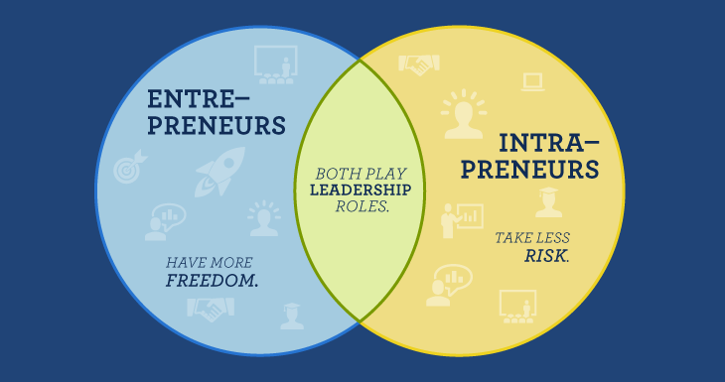
What is Intrapreneurship?
The idea that a person or organization can see a product on the market and develop and sell a strong competitor to that item
Intraprenuers see something good and try to make it better
Parts of intrapreneurship
Yourself
Project
Mentor/project leader
Benefits
Empowers employees
Encourages creative thinking
Improves upper level/ lower level relations

Slide 5
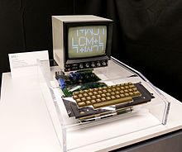
Apple’s Intraprenuership Strategy
Apple was founded on the principles of intrapreneurship
Apple 1 hit the market over a full year after the first personal computers started to become mainstream
Make something that is already good great
Tablets and the iPad
Personal computers and The Macintosh
Company culture focused on improvement
Giving customers what they didn’t know they needed

Slide 6

What is Innovation?
The introduction of something new or better, as in goods or services
Every aspect of a company can be innovative
Customer relations
New products
Services
Advertising
Management
Notes:
Texbook page 24

Slide 7
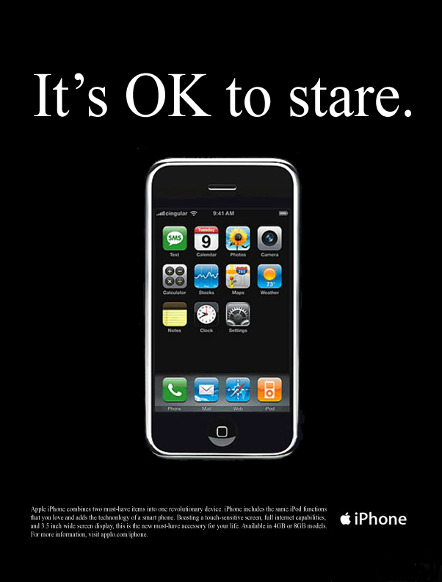
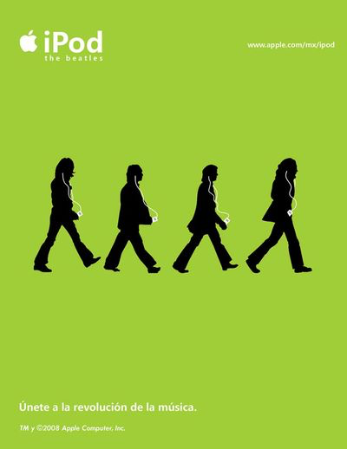
Apple’s Innovation Strategy
Innovation is cultural, not process driven
Most successful Apple products are created by a few people
Little to no structure, hierarchy, corporate oversight
Harness creativity from the people to get new ideas, designs, and innovations
Utilize intrapreneurs for new products
Use Strategic Management
Provide Direction and Momentum
Encouraging New Ideas
Develop Sustainable Competitive Advantage
Simplicity
“to turn really interesting ideas and fledgling technologies into a company that can continue to innovate for years, it requires a lot of disciplines,” -Steve Jobs
Notes:
Competitive advantage in things like operating systems and imessage and facetime
Even have Simple looking apps (2d, not many colors)

Slide 8
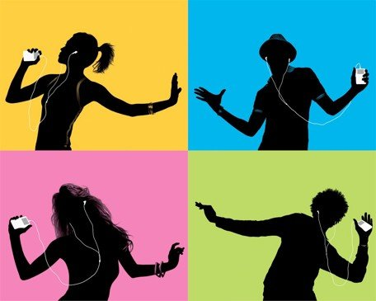
Innovative Marketing
Countless classic ad campaigns
Test drive a Mac
“1984 won’t be like 1984”
“There’s an app for that” campaign
iTunes dancing ads
Think Different campaign
Focus less on the product and more on how the product makes you feel
Focused on customer needs and simplicity
Important people use Apple products
Notes:
Apple’s marketing is what differentiates them from other company
Countless memorable ads
Selling less products AND
Selling more about the way the products make you feel
Apple ads tend to evoke a level of emotional appeal. Rather than specs
Focused on customer needs, simplicity
Celebrity marketing. Every famous person uses apple. Apple products are in almost piece of media:
Tv shows
Movies
Talk show

Slide 9

Apple: World’s most innovative company
Steve Jobs Mission Statement: To make a contribution to the world by making tools for the mind that advance humankind
Current Mission statement: To bring the best user experience to its customers through its innovative hardware, software, and services.
Seamless integration between devices
Cover all Tech platforms
Apple storefronts
Notes:
Apple has been named the most innovative company by a plethora of sources including BCg (boston consulting group)
Innovation is a spirit that is reflected in their mission statement.
Older Mission statement ….
As a group we kind of agreed that the older mission statement sounds better.
Old mission statement = non-techy world
New mission statement = techy world
Regardless apple adheres to their mission statement
These are specific examples of how apple is innovative.

Slide 10

Seamless integration between devices
Smooth integration across devices
iMessage on Mac
iPhone is iPod that can make calls
iCloud
Encourages: Have apple? Buy more apple!
Allows for optimized use of technology
Ease of Use
Notes:
This adheres to their mission statement….
Effective use of tech holistically instead of standalone devices
Integration solves problems that people face throughout usage
Moving from laptop to phone
Sending someone files: airdrop
Wifi password sharing

Slide 11

Cover all tech platforms
They offer innovative technology solutions for every consumer.
iPhone
Apple pay
Apple music and iTunes
Macbooks
etc….
Offer almost all tools to adhere to their mission statement
Notes:
Cover all tech platforms allows them to provide a one-stop solution
Innovative because tech is supposed to make things simpler
Adhere to their mission statement

Slide 12
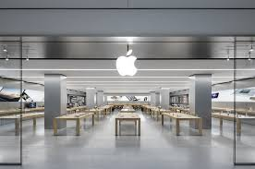
Apple Stores
Integration within society
Clear contact with market
Interaction with customers = more of an experience
Open floor plan with simple design
Store is designed just like products and ads
Provides and presents high-tech tools in a simple and non-techy manner
Genius Bar
Personal experience vs Phone customer service
Notes:
Apple came in at the right time in the right way.
Stores reflect simplicity
Easy help, good experience
Give google’s example: “Where would you go to buy google”

Slide 13
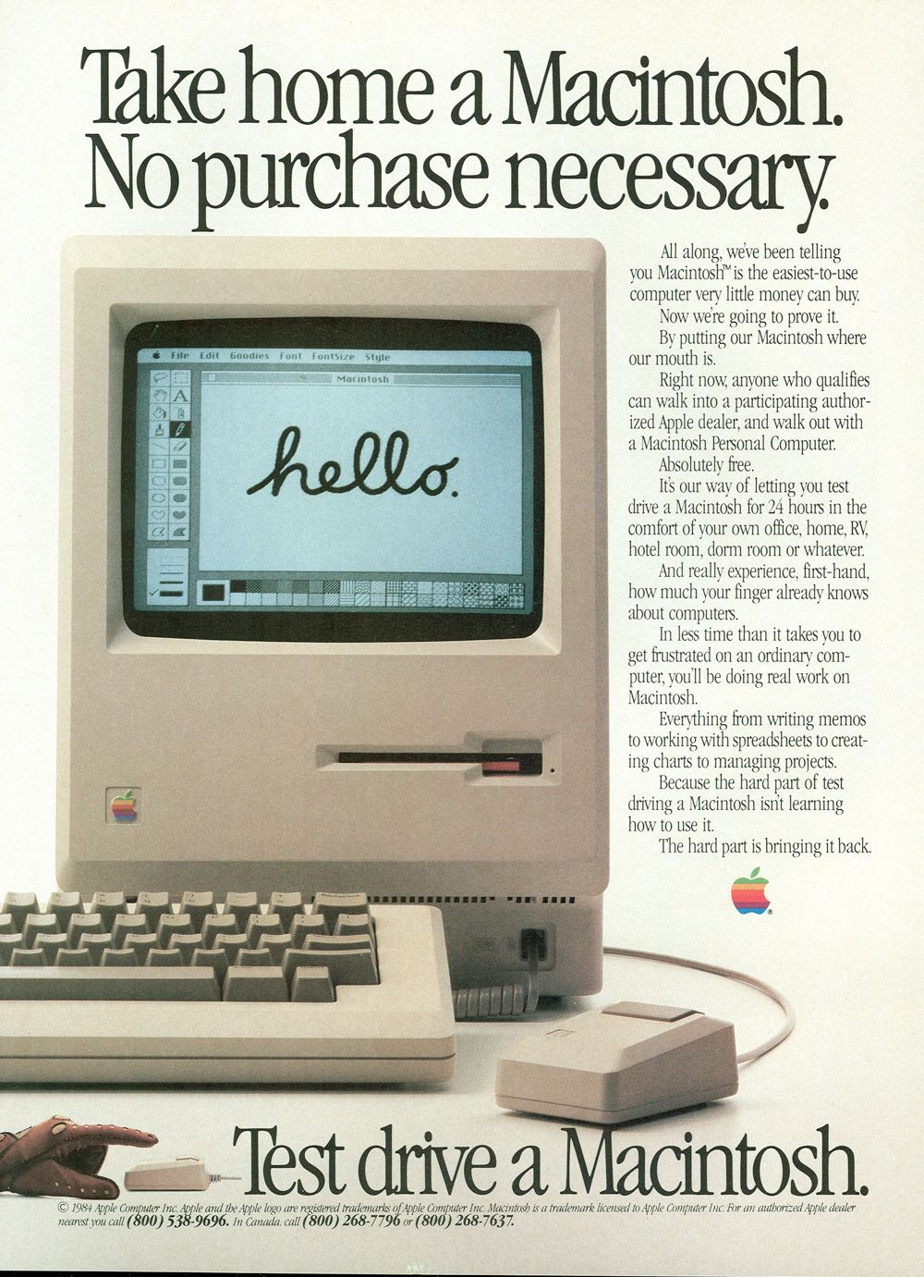
The Macintosh
Cornerstone of Apple’s intrapreneureal culture
Employee Jef Raskin envisioned low-cost personal computer for normal people
Formed a team and made the computer
The team operated independently from the rest of Apple and was personally run by Steve Jobs
Almost all self contained
First to be sold with mouse and keyboard
Convenience almost always wins
Were able to keep costs lower than competitors while also having better specifications
Idea came organically because of company culture
Innovative because it was simple yet powerful

Slide 14

The iPod and iTunes
First seamless online music store
Streamlined specifically for the iPod
Quick download times
First to allow you to sample a song before buying it
iPod was first sleek music player
Other MP3 players were big and clunky
iPod could hold thousands more songs than competitors
Notes:
Company culture is important. Innovation is very evident in their company culture. It is what has allowed them to stay relevant and successful today

Slide 15
Sources
https://www.britannica.com/topic/Apple-Inc
https://www.marketing91.com/apple-competitors/
http://innovarsity.com/coach/bp_innovation_strategies_apple.html
https://www.forbes.com/sites/louiscolumbus/2018/01/20/apple-leads-bcgs-2018-list-of-the-most-innovative-companies/#344de5135a94
https://lowendmac.com/2014/personal-computer-history-the-first-25-years/
https://history-computer.com/ModernComputer/Personal/Macintosh.html
https://www.cnn.com/2013/04/26/tech/web/itunes-10th-anniversary/index.html
https://www.macworld.com/article/1163181/the-birth-of-the-ipod.html

Slide 16
Sources
http://panmore.com/apple-inc-organizational-culture-features-implications
https://www.cnbc.com/2016/04/29/apple-product-innovations-that-changed-the-world.html
https://www.crazyegg.com/blog/why-is-apples-marketing-good/
https://gigaom.com/2010/07/07/what-makes-an-apple-store-so-great/
https://www.selfgrowth.com/articles/steve-jobs-the-ultimate-intrapreneur-and-entrepreneur
Management: A Practical Introduction

Slide 17
Image Sources
https://www.ocregister.com/apple-becomes-1st-trillion-dollar-company-san-francisco-ap-apple-has-become-the-worlds-first-publicly-traded-company-to-be-valued-at-1-trillion-the-milestone-marks-the-financ
https://www.iphonesavior.com/2008/11/beatles-ipod-ad-inspires-hope-for-itunes-release.html
https://vulcanpost.com/586452/tim-cook-100m-apple-spend/
https://en.wikipedia.org/wiki/ITunes
https://www.engadget.com/2013/03/29/securing-your-ios-device-for-your-children-part-1-setting-up-a/
https://bgr.com/2016/10/21/iphone-theft-apple-store-robbery/
https://en.wikipedia.org/wiki/Apple_I
https://www.pinterest.com/pin/397372367092530166/

